Slide 1
UKIEPC 2017
Summary and solution outlines rgl@google.com

Slide 2
UKIEPC Names
Organisers: Max Wilson, James Davenport, Rachid Hourizi
Writers: Robin Lee, Jim Grimmett, Kiril Dichev
Reviewers: Ian Pratt-Hartmann, Sander Alewijnse
Infrastructure: Neil Francis, Matt Richards
Illustrator: Lisa Abose

Slide 3
Problem Solutions

Slide 4
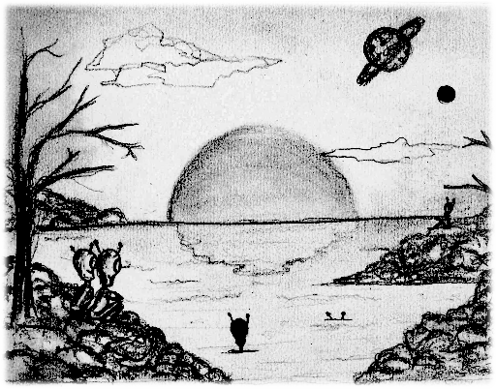
A - Alien Sunset
Overview
A number of planets, each with varying sunrise and sunset and different length days.
Identify the earliest time all of the planets are in darkness.
If it takes too long, output impossible.
102 correct • solved at: 00:26 by
Tractor_Specialists (Oxford)
Author: Jim

Slide 5
Alien Sunset - Solution
Techniques
Algorithm
LCM
Intervals
Find the longest day length, multiply by 1825, and iterate through every hour up to there starting from 1.
For each planet, is the hour chosen in their nighttime?
If yes, we have a solution.
Otherwise, try the next hour.
If we reach the end of the timespan, “impossible”.
O(Hours * Planets).

Slide 6
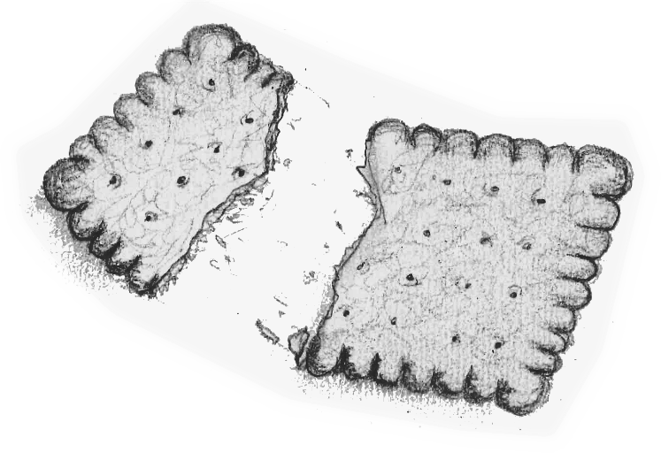
B - Break Biscuits
Overview
A given irregularly-shaped biscuit will be dunked into an infinitely deep, straight-sided mug.
How wide does this infinite mug need to be to accommodate the biscuit?
23 correct • solved at: 00:36 by
AibohphobiA (Edinburgh)
Author: Robin

Slide 7
Break Biscuits - Solution
Techniques
Algorithm
Convex hull
Rotating calipers
If the mug is just large enough to contain the biscuit, the biscuit can’t rotate once it’s inside. At least 3 of its vertices must touch the side of the mug.
Find the convex hull of the biscuit using, for example, Andrew’s monotone chain algorithm.
Iterate over the edges of the biscuit. Keep track of the “farthest vertex” from the current edge. The answer is the smallest such distance among all edges.

Slide 8
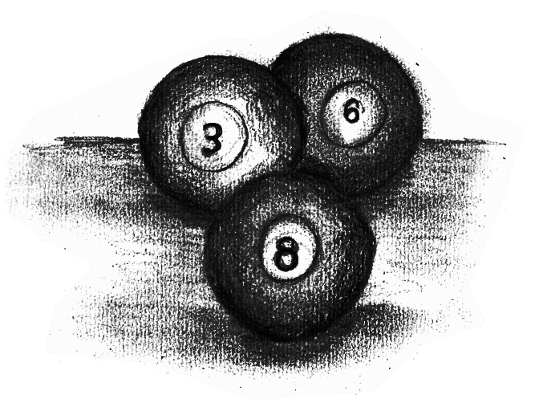
C - Cued In
Overview
Various coloured balls are on the snooker table. The value of each ball is given.
Balls must be potted in alternating red:colour:red:colour order until no reds are left.
Work out the maximum remaining score if all balls are potted.
162 correct • solved at: 00:07 by
AKSLOP-7991 (Cambridge)
Author: Jim

Slide 9
Cued In - Solution
Techniques
Algorithm
Greedy
String matching
We must pot reds with colours.
Read in the colour of each ball, determine its value.
To gain the maximum score, pot each red with the highest value colour (C_{max}). We then pot the remaining colours.
As each red has a value of 1, if the number of reds is R and the sum of the colours is S the maximum is:
R(1+C_{max}) + S
Special case: 100% of the balls are red

Slide 10
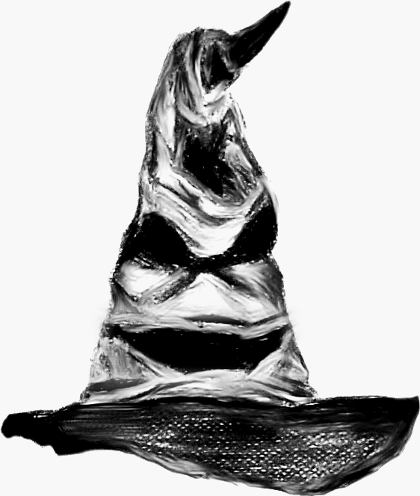
D - Deranging Hat
Overview
Generate a sorting network to “un-sort” an array back into its original state.
Use at most 10 * MAX_N swaps.
71 correct • solved at: 00:09 by
PrimeGoal (Cambridge)
Author: Robin

Slide 11
Deranging Hat - Solution
Techniques
Algorithm
Data structures
Permutations
The mapping from the sorted string to the original string is a permutation.
Because, in a permutation, every vertex has one in-edge and one out-edge, a permutation graph is a set of disjoint cycles.
If we need to move [0] to [1], [1] to [2], [2] to [3], and [3] to [0],this can be done in N-1 swaps
Swap [2] with [3] (2 3) if [2]>[3]; (3 2) otherwise.
Swap [1] with [2] (1 2) if [1]>[2]; (2 1) otherwise.
Swap [0] with [1] (0 1) if [0]>[1]; (1 0) otherwise.
Pitfall: Ordering of letters changes over time. Simulate the swaps on a sorted string to keep track.

Slide 12
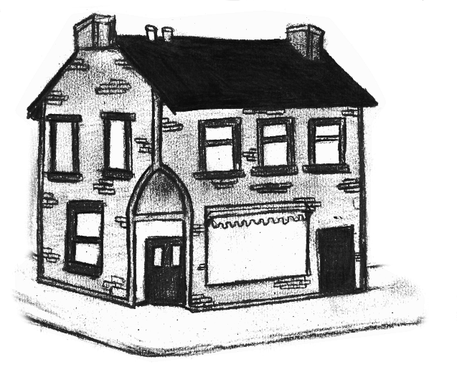
E - Education
Overview
Given a list of Departments and the number of students in each.
Given a list of available rooms, their capacities and costs.
Identify the minimum cost to house all of the Departments in separate rooms.
58 correct • solved at: 00:36 by
FakeMaths (Cambridge)
Author: Jim

Slide 13
Education - Solution
Techniques
Algorithm
Greedy matching
Sorting
Assignment problem
Greedy: keep putting the largest unassigned class in the cheapest building available.
This works because for any two class sizes A < B, the choice of buildings for B is a subset of the choice for A with identical scores.
Implementation
Keep two sorted sets of buildings, both initially full:
P (sorted by price first)
S (sorted by size first)
Iterate through classes C in decreasing order of size
While the max element of S is too large, delete from S and P.
Remove the smallest element of P and assign it to C.

Slide 14
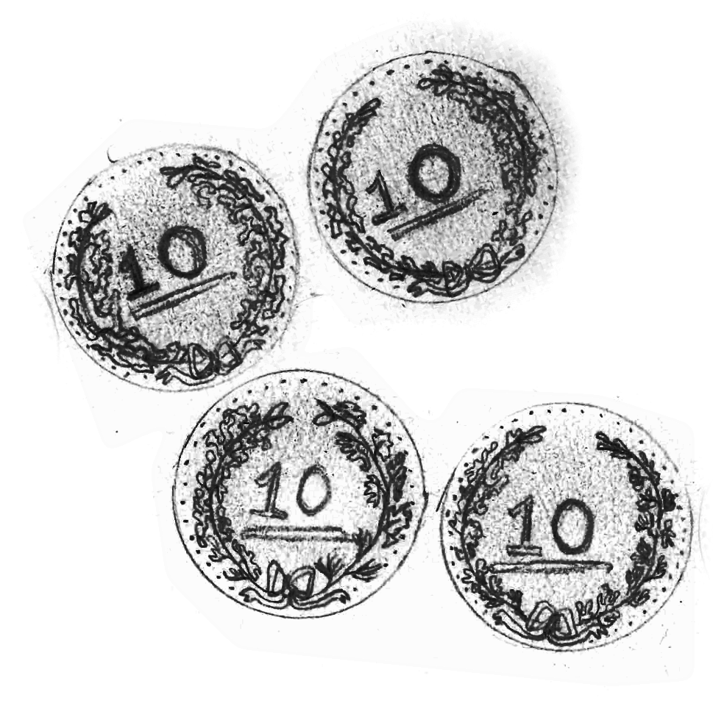
F - Flipping Coins
Overview
We have N coins face-down.
You must pick up a single coin and flip it randomly, exactly K times.
If you can choose the next coin to flip, what’s the maximum expected number of coins heads-up at the end?
49 correct • solved at: 00:16 by
Me[N]ta∭ca (Cambridge)
Author: Robin

Slide 15
Flipping Coins - Solution
Techniques
Algorithm
Combinatorics
Dynamic programming
Personal finance
Dynamic programming state: {head_count, flips_left}
If we have no flips left, the answer is the number of heads we have
f(h, 0) = h
If at least one tail is left, flipping it gives a 50% chance of 1 extra head, or a 50% chance of nothing changing.
f(h, k) = 0.5 * f(h+1,k-1) + 0.5 * f(h, k-1)
Otherwise, it’s necessary to flip a head and have a 50% chance of reducing the score.
f(N, k) = 0.5 * f(N,k-1) + 0.5 * f(N-1,k-1)
f(N, k) = N - 0.5

Slide 16
Flipping Coins - Solution (alternative)
Techniques
Algorithm
Combinatorics
Dynamic programming
Personal finance
Either we make fewer successful flips to heads (X) than N, or a greater or equal amount of flips.
If we made fewer, we’ll have X heads at the end.
And there are N choose X ways of getting there.
Otherwise, the answer depends on the final flip.
If successful (result = N), there are N-1 choose X-1 ways.
If unsuccessful (result = N-1), there are N-1 choose X ways.
Add the possible ways up for all X, and divide by 2^{K}.

Slide 17
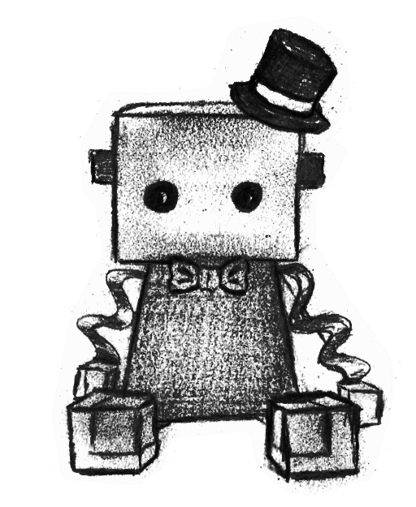
G - GentleBots
Overview
Two polite robots need to navigate from points A to B without bumping into each other.
Find any list of moves that accomplish this in no more than 7000 steps.
33 correct • solved at: 01:19 by
PrimeGoal (Cambridge)
Author: Kiril

Slide 18
GentleBots - Solution
Techniques
Algorithm
Ad-hoc
Escape problem
Many strategies that work. Most have edge cases -- it’s very easy to accidentally get stuck in a loop.
An easy-to-implement one:
Move both robots towards their goals repeatedly.
If the robots collide, undo the last move, pick a random robot and move it in a random direction instead.
Other approaches that work:
Plan one robot’s path, then plan the other path around it.
Resolve conflicts with a small depth-first-search.
Maximum flow!

Slide 19
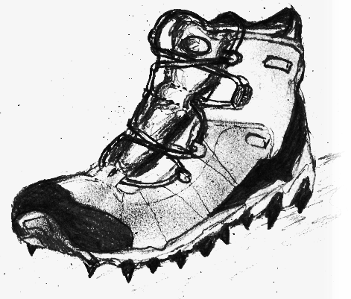
H - Hiker Safety
Overview
We have a one-dimensional track we need to move people along.
Everyone has a specific minimum and maximum distance they need to keep to their neighbour.
Once someone reaches the end of the track, their constraints don’t matter any more.
6 correct • solved at: 02:32 by
FakeMaths (Cambridge)
Author: Robin

Slide 20
Hiker Safety - Solution
Techniques
Algorithm
Greedy
Two pointers
If we have just two people, greedy works:
As long as either of the two hikers can move without violating constraints, move them forward.
We end up with a sequence of moves like AABBABBAB
When there are three or more, solve for adjacent pairs of people and then merge all the solutions together.
Eg. AABAB + CBBC = AACBABC
A hiker is eligible to move whenever they’re first in all lists they appear in. Keep count and update “who’s next” after every move.

Slide 21
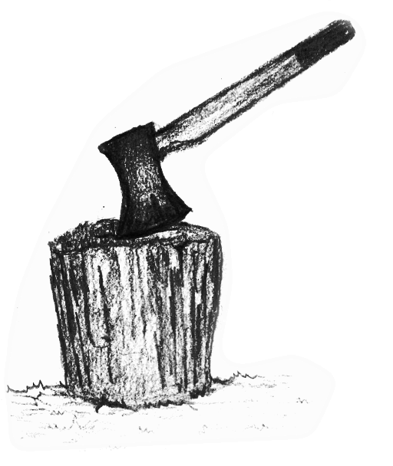
I - I Work All Day
Overview
A tree-chopping machine keeps cutting down an N-height tree into logs of size L, or smaller if necessary.
For example, if N=15, L=4, we get “4 4 4 3”.
We want to make the size of the last log as small as possible.
Given several possible values of L, what’s the best one to use?
163 correct • solved at: 00:04 by
did you do D (Cambridge)
Author: Robin

Slide 22
I Work All Day - Solution
Techniques
Algorithm
Modulo
Sorting
The chopping robot is an over-explained implementation of the modulo function (%).
Map each of the inputs into a tuple (tree % X, X) and sort it using your language’s built-in sort() function.
The answer is now the first element in the list.

Slide 23
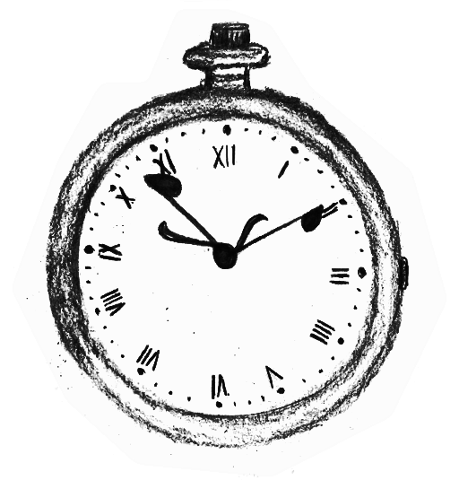
J - Just a Minim
Overview
Given are a number of notes in a tune and the length of each of those notes.
Find the length of the tune, in seconds.
158 correct • solved at: 00:06 by
-= [B]ichael [B] [B]iggins =- (DCU)
Author: Jim

Slide 24
Just a Minim - Solution
Techniques
Algorithm
Floating point
Powers
Write a function to convert numbers to notes.
Hardcode it, or
Special-case 0 and use f(x) = 1.0 ÷ (double) x for the rest
Iterate through the array calling the function. Accumulate all the answers together at the end.

Slide 25
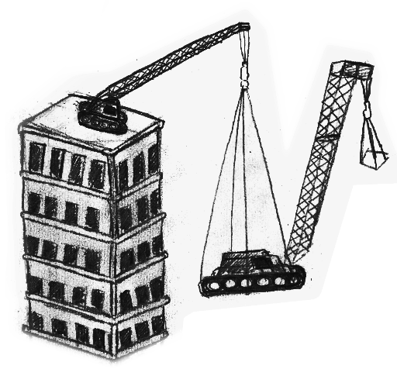
K - Knightsbridge
Overview
Several buildings each need a crane on top that can lift some given weight.
A crane can only be lifted up onto the top of a building if another crane strong enough to lift its weight is already there, or if its weight is 0.
Find a sequence of distinct cranes to put on top of each building.
15 correct • solved at: 02:13 by
Hello World (Edinburgh)
Author: Robin

Slide 26
Knightsbridge Rises - Solution
Techniques
Algorithm
Disjoint paths
Maximum flow
Directed acyclic graphs
Draw a directed graph, adding an edge from crane A to crane B if and only if A.strength ≥ B.weight.
The answer will be a set of vertex-disjoint paths through this graph, one for each building, each ending in a crane strong enough for that building.
Classic maximum flow transformation: split every vertex into two virtual halves, “in” and “out”.
Draw an edge between “in” and “out” with unit capacity. This means the vertex can only be used for one path.
Add a sink vertex for each building, an edge from the source to any crane with 0 weight.
Apply any reasonable max-flow algorithm.

Slide 27
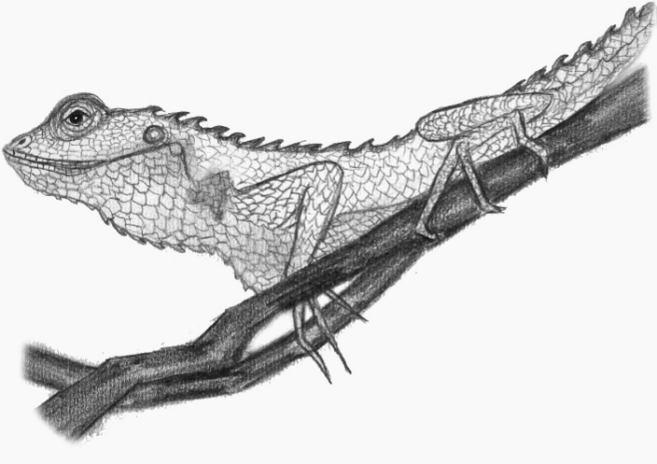
L - Lounge Lizards
Overview
Monitor lizards are sitting around a television screen.
A lizard can see the TV if it is taller than all the lizards on the straight line to the television.
How many lizards can see the screen at once if we remove an optimal subset?
18 correct • solved at: 01:41 by
Me[N]ta∭ca (Cambridge)
Author: Robin

Slide 28
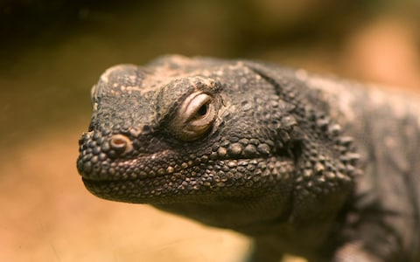
Lounge Lizards - Solution
Techniques
Algorithm
Patience algorithm
Common divisors
Geometry
Save lizard positions as vectors relative to the television.
Two lizards i and j intersect iff d[i] * t = d[j] for some t
Canonicalise every vector by taking the GCD of its x and y, dividing through, and saving that part as its “length”.
(6, 12) becomes (1,2)*2
(-9, -6) becomes (-3,-2)*3
Group lizards by direction. Sort each group by GCD as a proxy for distance.
The answer for any one group of lizards is its Longest Increasing Subsequence. Patience sorting is fast and easy to implement.
O(NlogN) dynamic programming is also fast enough.

Slide 29
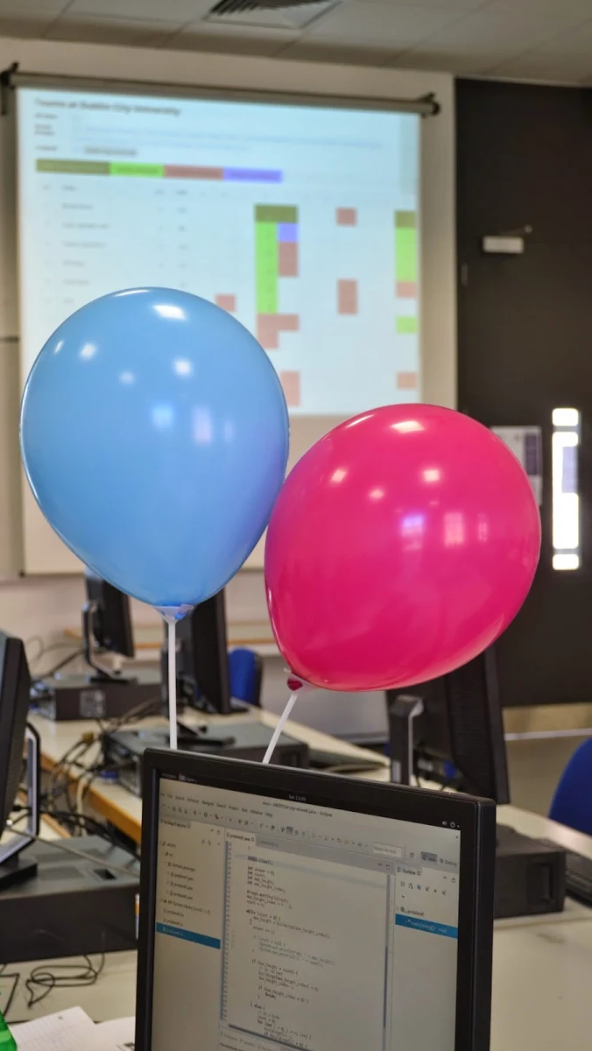
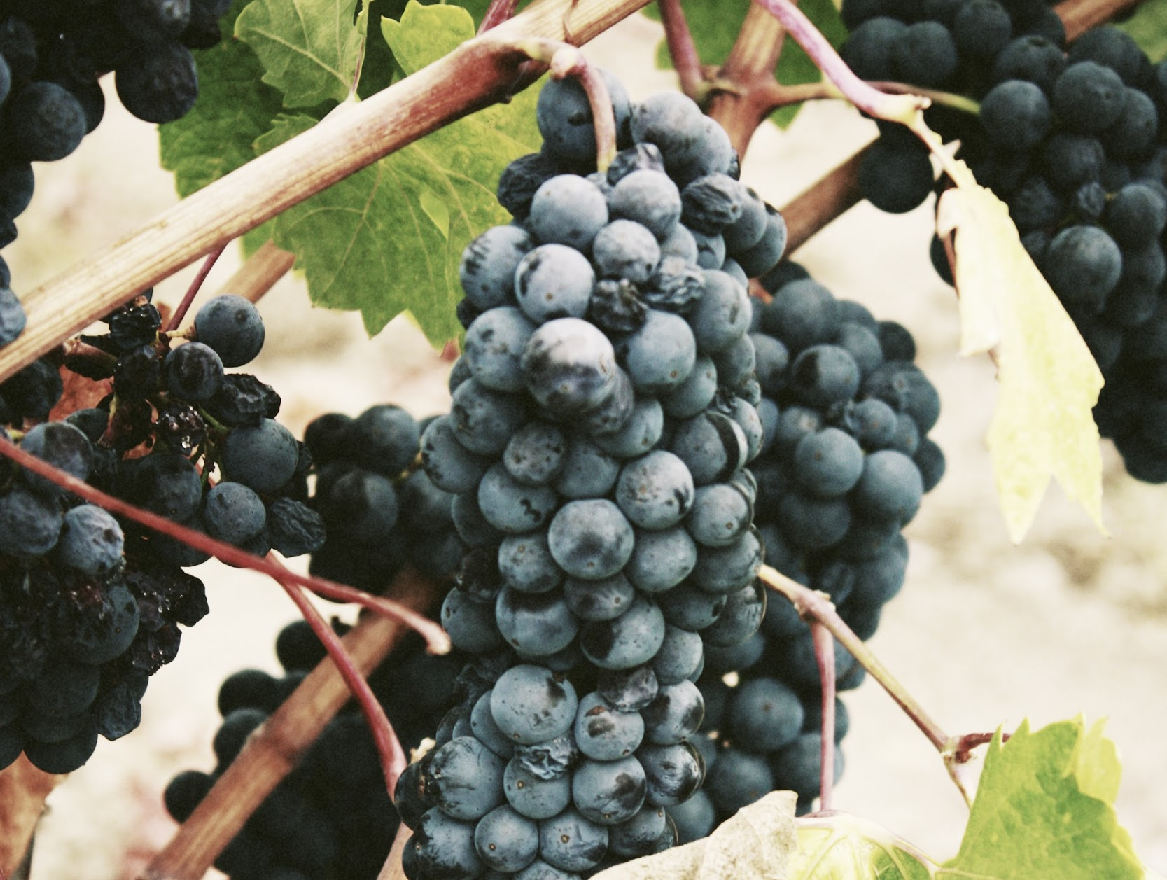

Slide 30
Questions?
Or comments?

Slide 31
Final Standings
http://domjudge.bath.ac.uk/

